Slide 1
DEPTH ESTIMATION FROM STEREO IMEGES USING CENSUS TRANSFORM
Name: Socaci radu andrei
Group: 30431
Supervisor: varga robert

Slide 2
Problem description
The purpose of the project is to create a disparity map, given two different perspective of the same image (viewed from the left and from the right). The two images need to be transformed (using Census) and compared against each other (using hamming distance). The result of the comparison is the horizontal displacement of a pixel P when changing the perspective (left -> right in this case).
The aforementioned comparison results are stored in a matrix, called disparity map, representing the result of the depth estimation algorithm.

Slide 3


Input example
Right perspective
Left perspective

Slide 4
Depth Estimation Process
Compute Census transformation
HAMMING
Precompute Hamming distances
DISPARITY
Compute disparity (min) and noise filtering
CENSUS

Slide 5
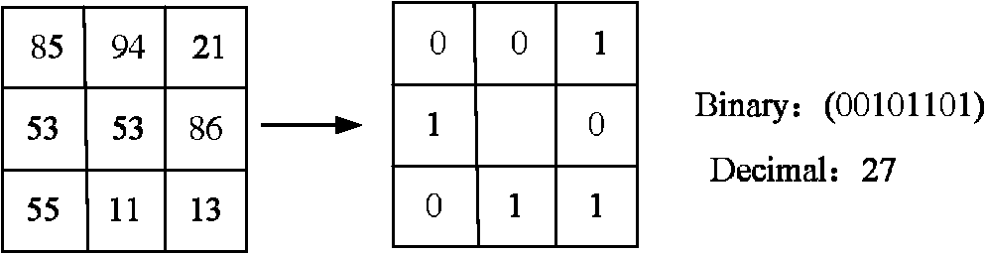
Census Transform
The Census transform attributes a bit string to each pixel of the image. The bit string is obtained by superposing a kernel of size k over the initial image and comparing each element in the kernel with the value of the current pixel.
If the current pixel’s value is lower than the kernel’s pixel, then we add a 0, else add a 1.
The middle position (current pixel) is ignored (since there is no need to compare the pixel against itself)

Slide 6
Hamming distance
Stereo matching
The result obtained after applying the Census transform on the input image is a bit string, corresponding to each pixel position in the image.
An extra step (named correlation step) is required, which compares the two bit strings corresponding to PR and PL (where PR = pixel P in right image and PL = P in left image). The result will be the number of bits that differ between the two.
The final result is obtained by matching the pixels and finding the horizontal displacement (disparity)
Two image pixels PL and PR match if they result from the projection of the same point P

Slide 7
Hamming Precomputation
In order to obtain a good result, the hamming distances need to be precomputed and saved in a 3D matrix. These results (the 3d matrix) are fed to an aggregation function, which overlaps a squared kernel over the results and sums all the entries in the kernel, resulting in another 3D matrix where S(i, j, d) = H(i-w:i+w, j-w:j+w, d).
H is the precomputed hamming matrix, where H(i, j, d) = Hamming(L_img(i, j), R_img(i - d, j)).
This implementation assumes that the left image is the reference image and the disparity is relative to the right image.

Slide 8
Disparity
The disparity value represents the horizontal displacement of pixel P from the left perspective to the right perspective. The domain of the disparity was implemented to be [0, 50] (which means that the two 3D matrices have depth of 50).
For each pixel P(i, j) the minimum value from the aggregated disparity matrix is selected (min(S(i, j, 0:50))). The domain of the resulted is than shifted to [0, 255] for optimal contrast of the resulting image.

Slide 9
Noise filtering
After the disparity computation step, the resulting image suffers from salt and pepper noise. Essentially, there are some outliers in the disparity maps’ pixels (black points). These imperfections can be corrected using a median filter (of size 10 in this case).
The filtering step can increase the accuracy of the output. This extra step is desired in order to improve the error percentage, obtained by comparison with the ground truth image, provided as input. The comparison threshold was limited to 2.

Slide 10
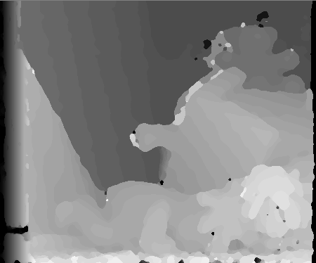
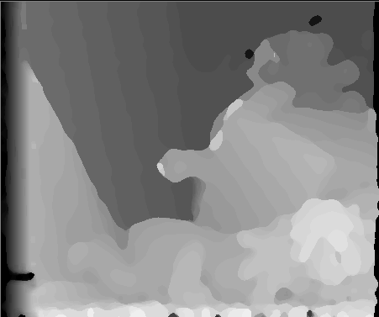
Filtering results
Median filter size 5
Median filter size 10

Slide 11
Error calculation
To assess the correctness of the implementation an error function was defined. The function compares each pixel in the resulting image with its corresponding ground truth pixel. If the difference is bigger than a given threshold (2 in this case), the pixel is counted towards the error pixels.
This number (sum of error pixels) is divided by the total number of pixels, thus yielding a percentage (and then multiplied with 100 for a more readable result).
The error is between 98-99% using this threshold.

Slide 12
Bibliography
http://www.cs.cornell.edu/~rdz/Papers/ZW-ECCV94.pdf
https://www.jstage.jst.go.jp/article/transinf/E100.D/11/E100.D_2017EDP7052/_pdf
https://pdfs.semanticscholar.org/1e0c/2c8535684f0b
http://vision.middlebury.edu/stereo/taxonomy-IJCV.pdf6293418e148b4f6d04829dce.pdf

